Slide 1
A Distributed Algorithm for 3D Radar Imaging
Patrick Li
Simon Scott
CS 252
May 2012

Slide 2
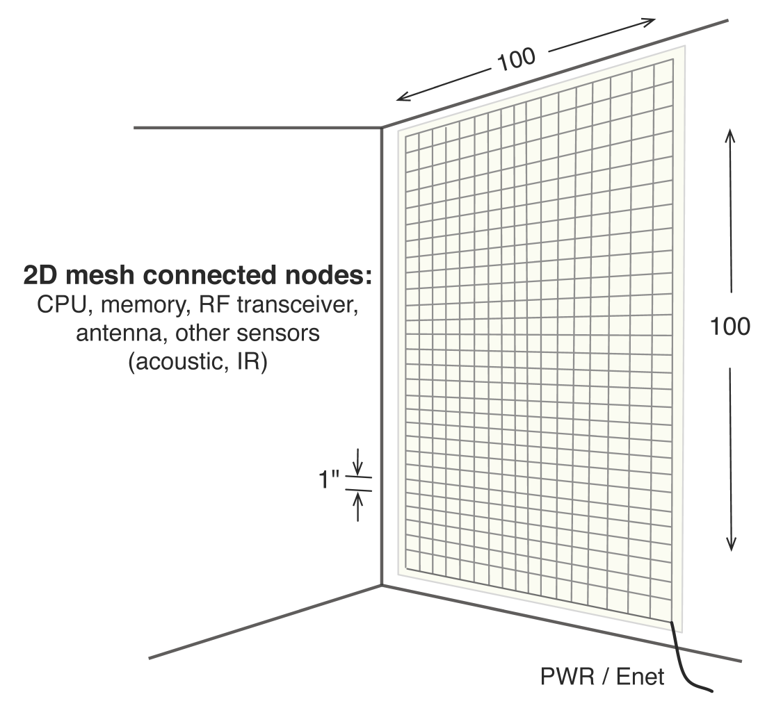
eWallpaper
Thousands of embedded, low-power, RISC-V processors.
Connected in 2D mesh network within wallpaper.
One radio and antenna per processor.
128
128

Slide 3
Applications and Challenges
Application:
Use the radio transceivers to image the room
Algorithm:
Each radio transmits pulses and records echoes
The echoes are combined using SAR techniques to form an image
Challenges:
Response distributed amongst the 16 000 processors
Restrictive 2D mesh topology
Limited local memory per processor (100KB)

Slide 4
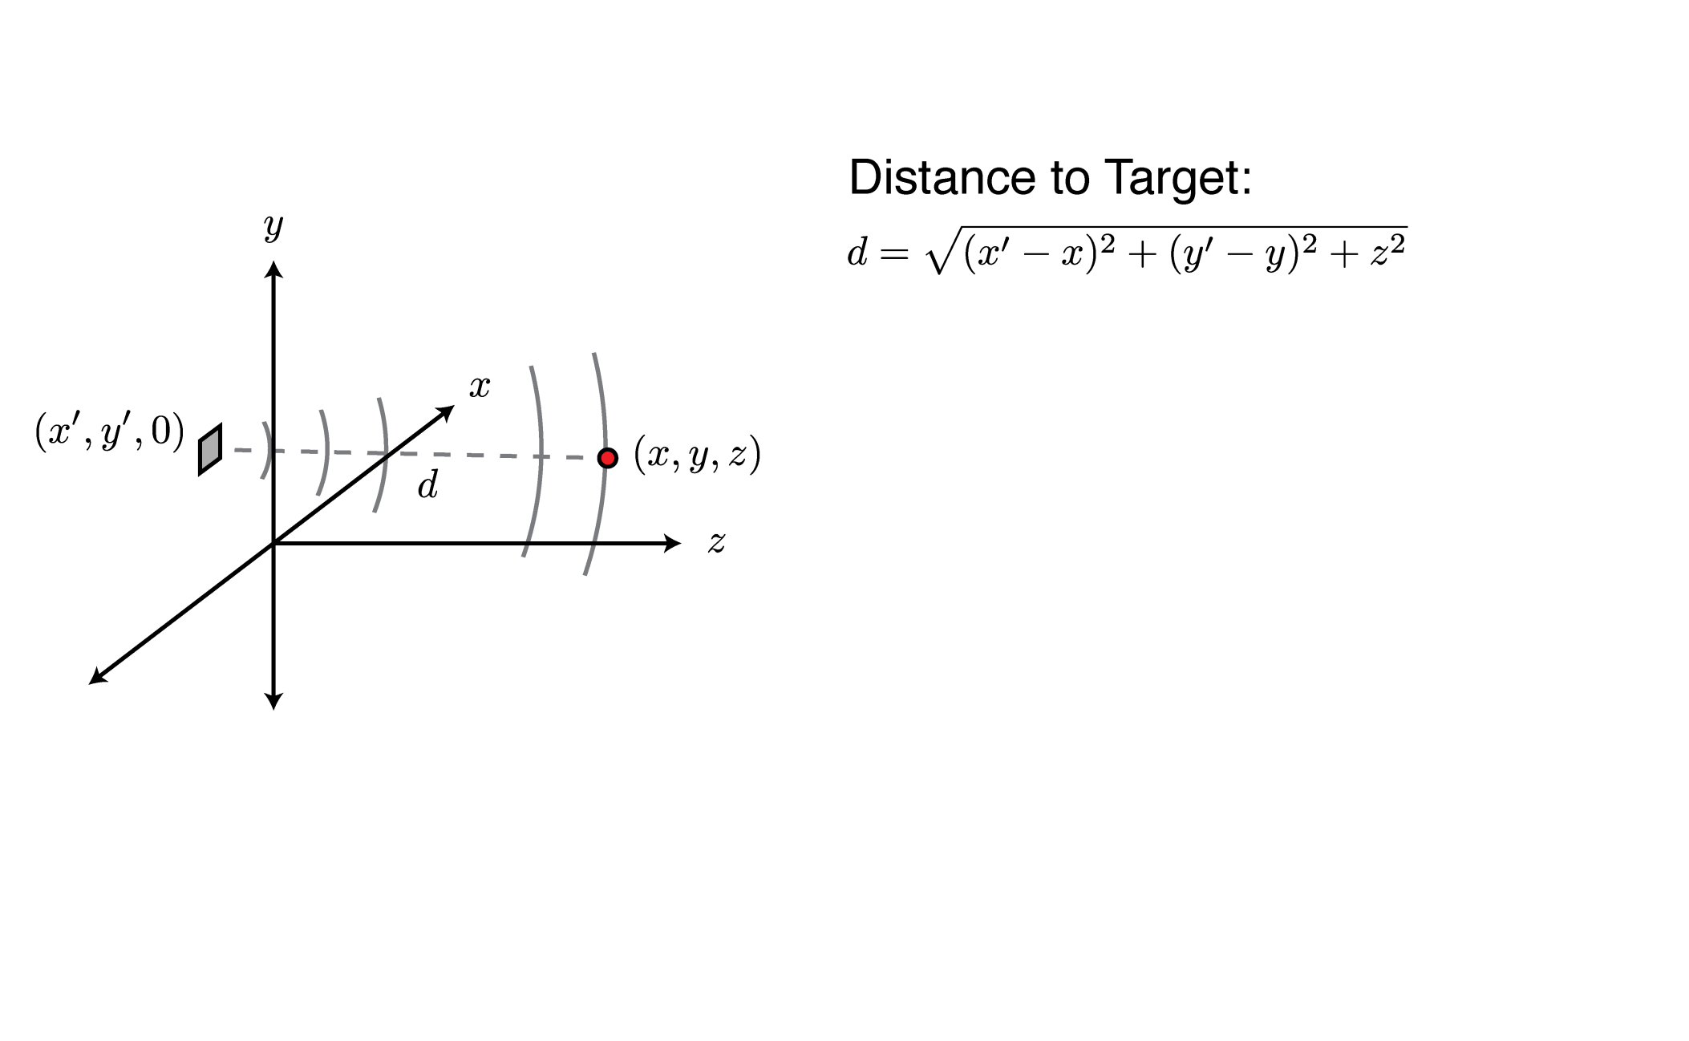
How it Works

Slide 5
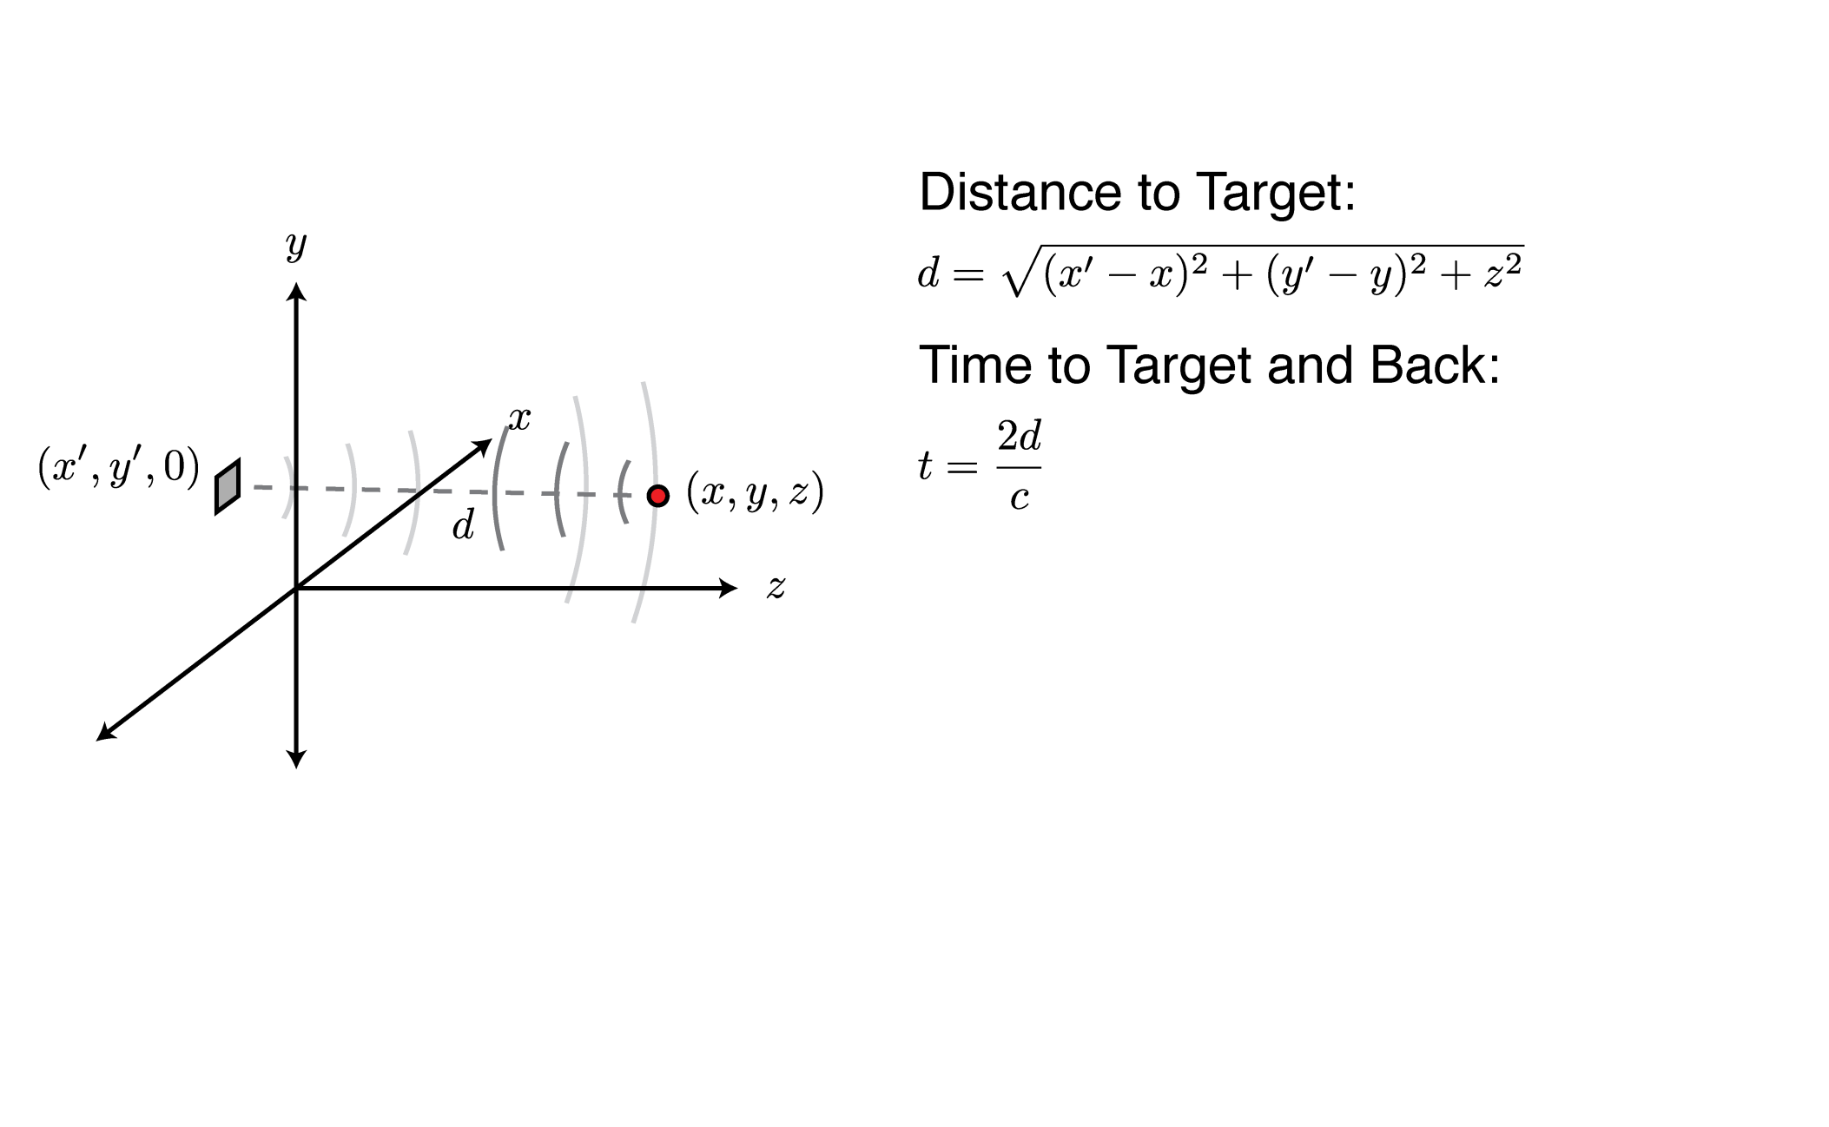
How it Works

Slide 6
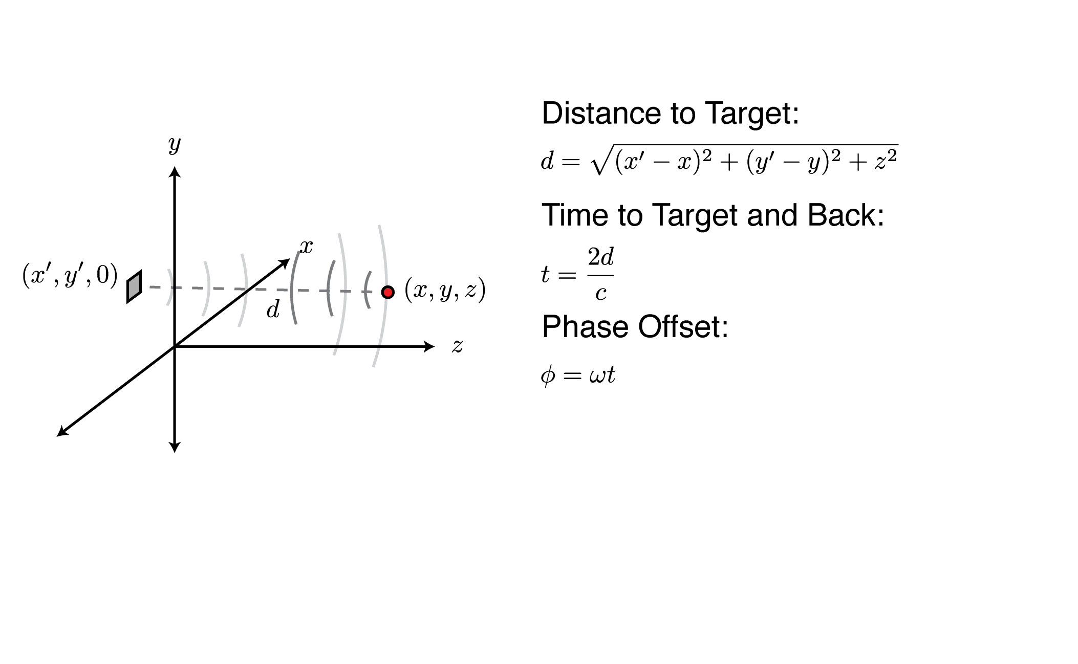
How it Works

Slide 7
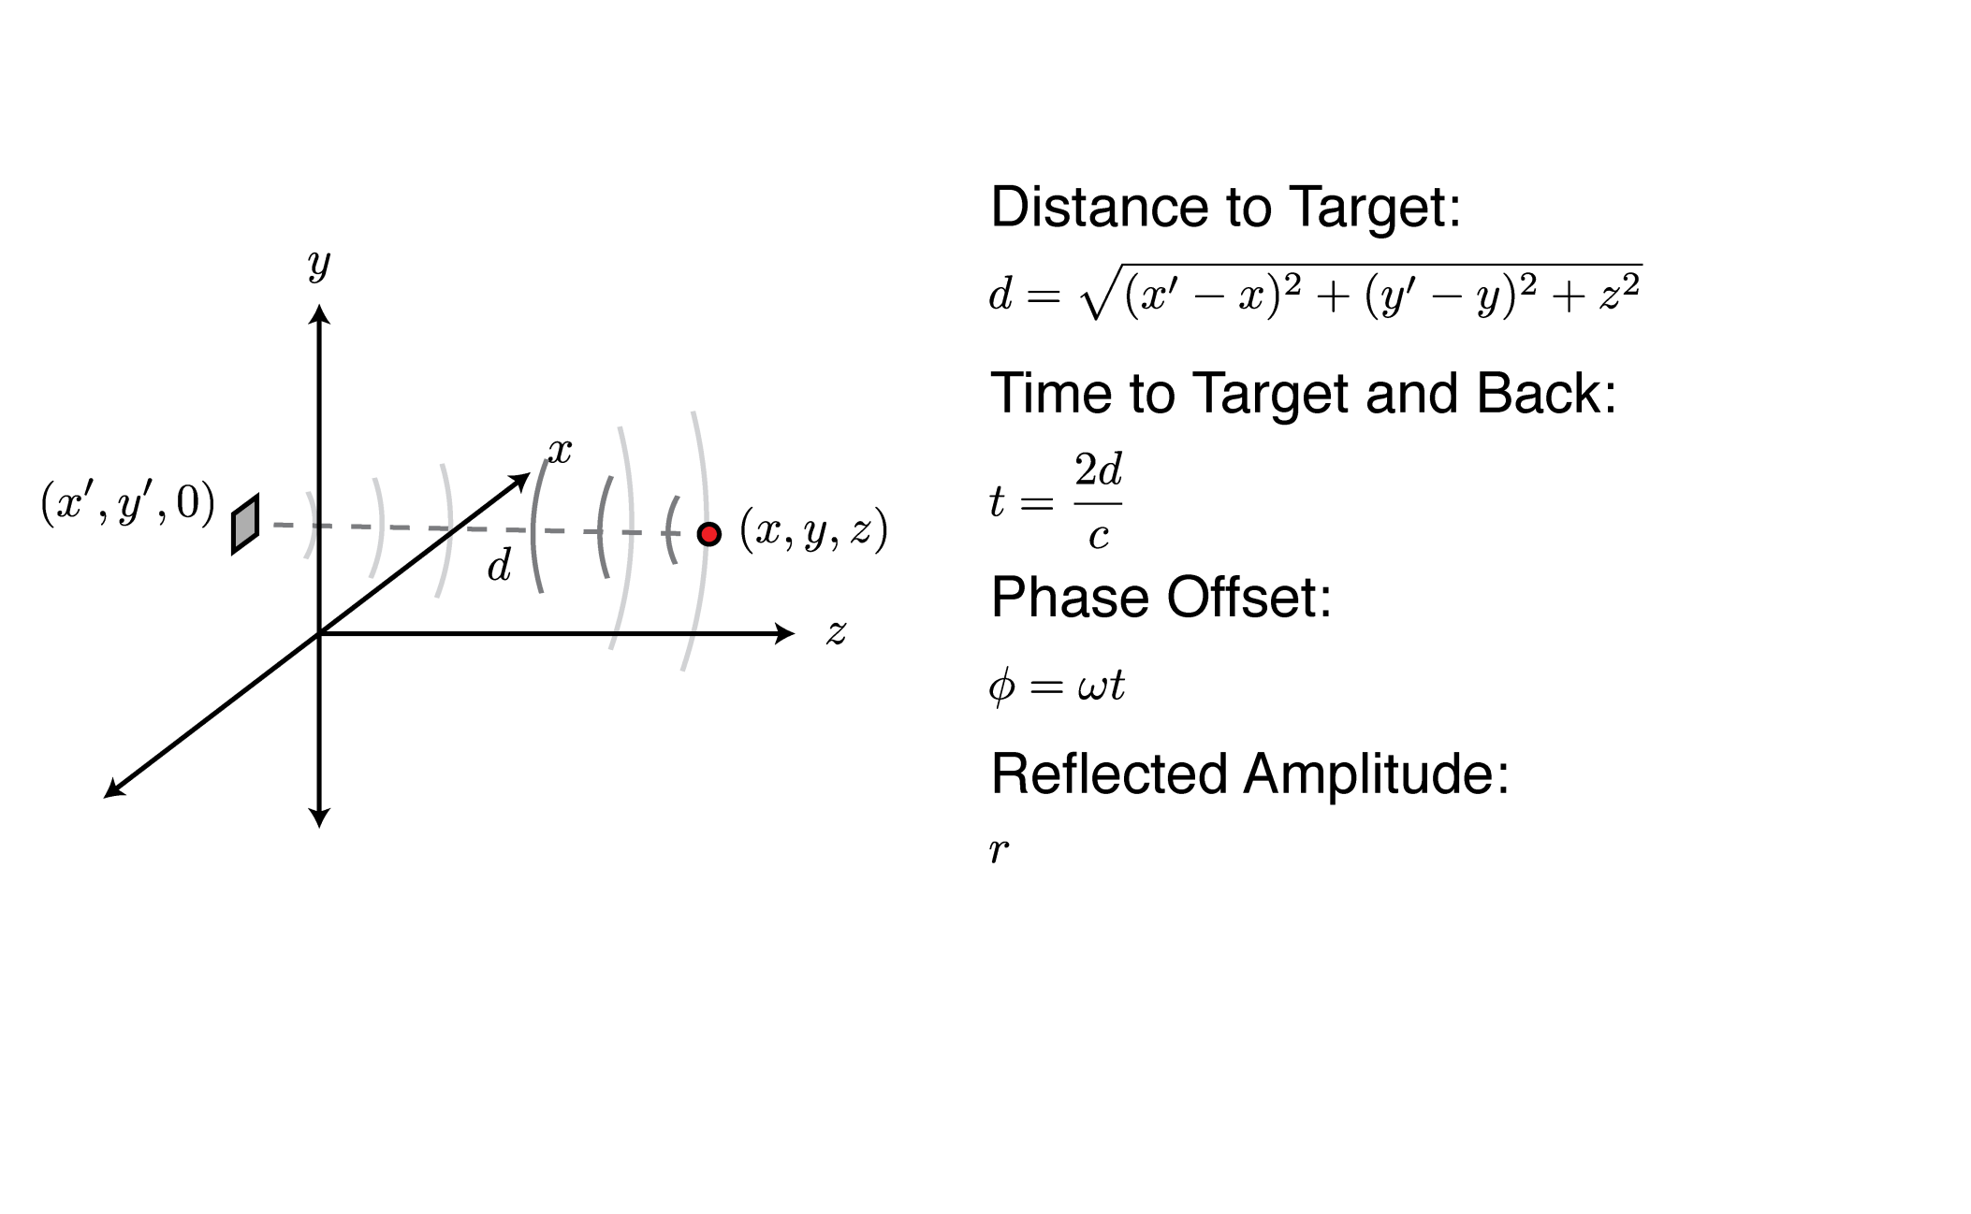
How it Works

Slide 8
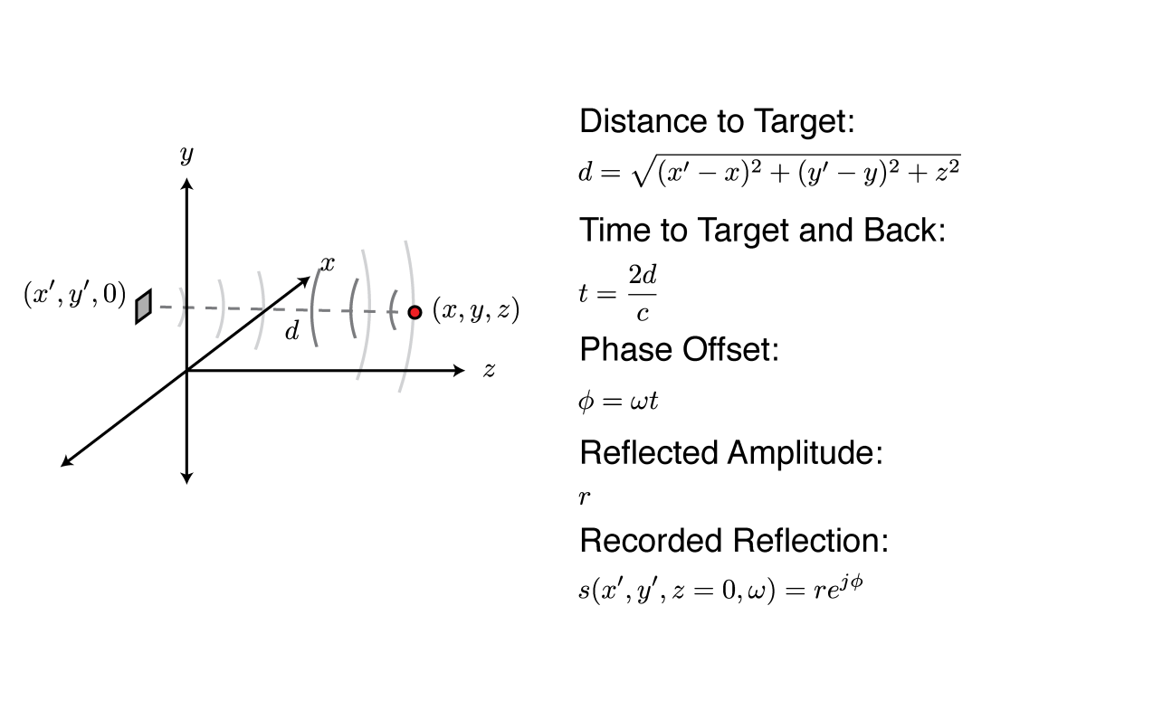
How it Works

Slide 9
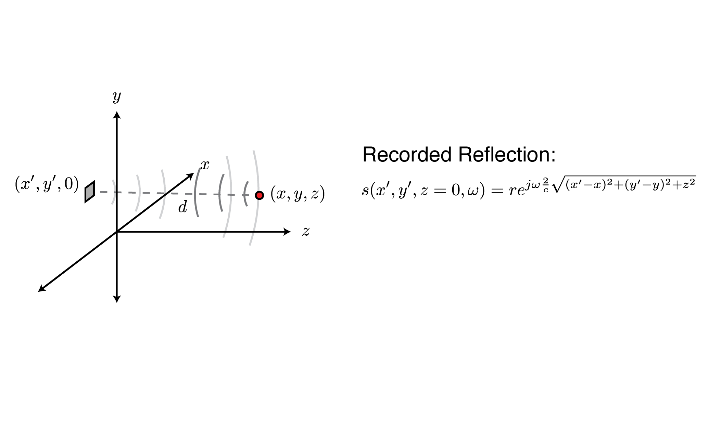
How it Works

Slide 10
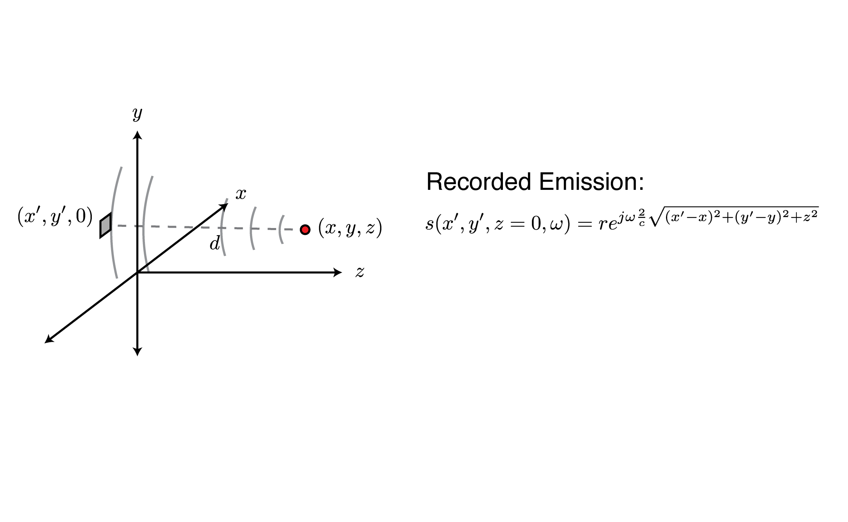
How it Works

Slide 11
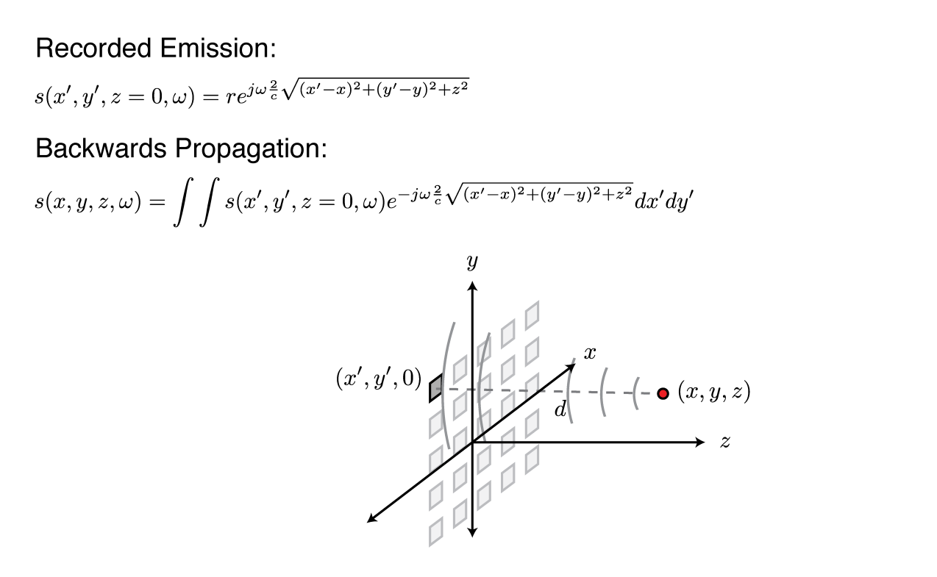
How it Works

Slide 12
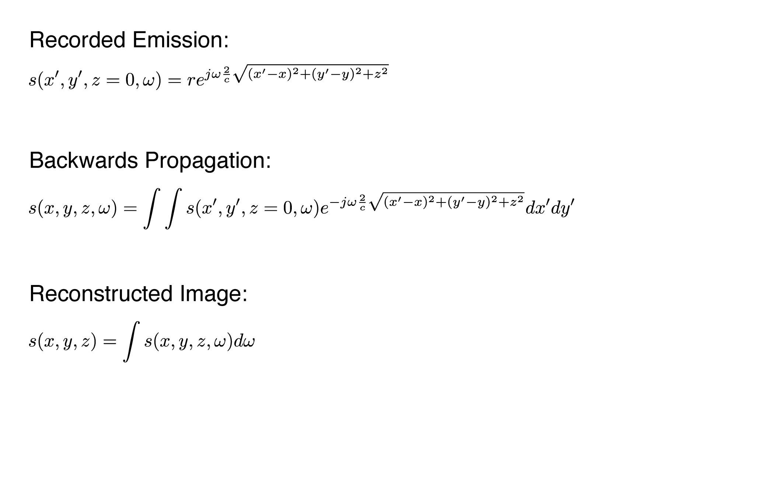
How it Works

Slide 13
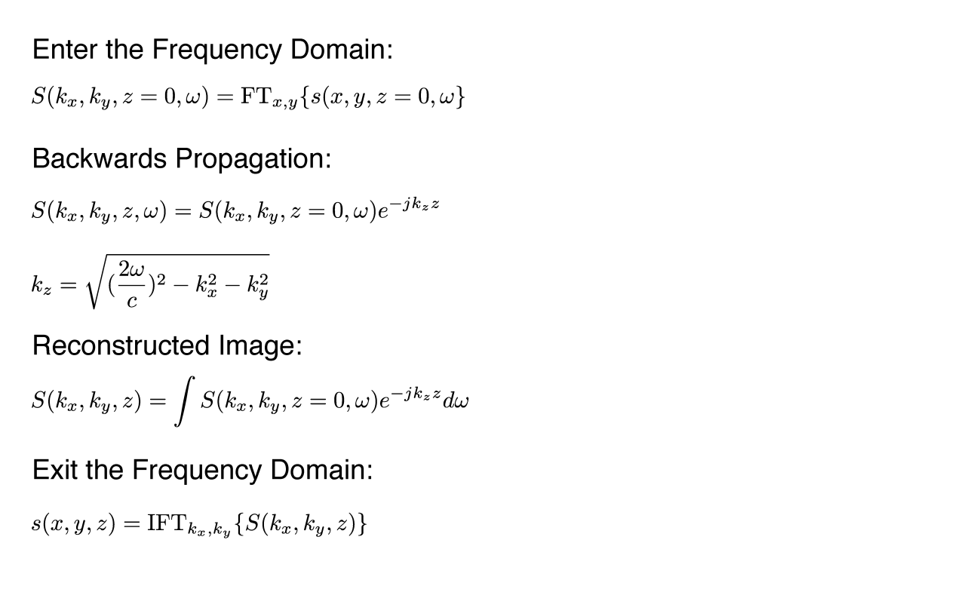
How it Works

Slide 14
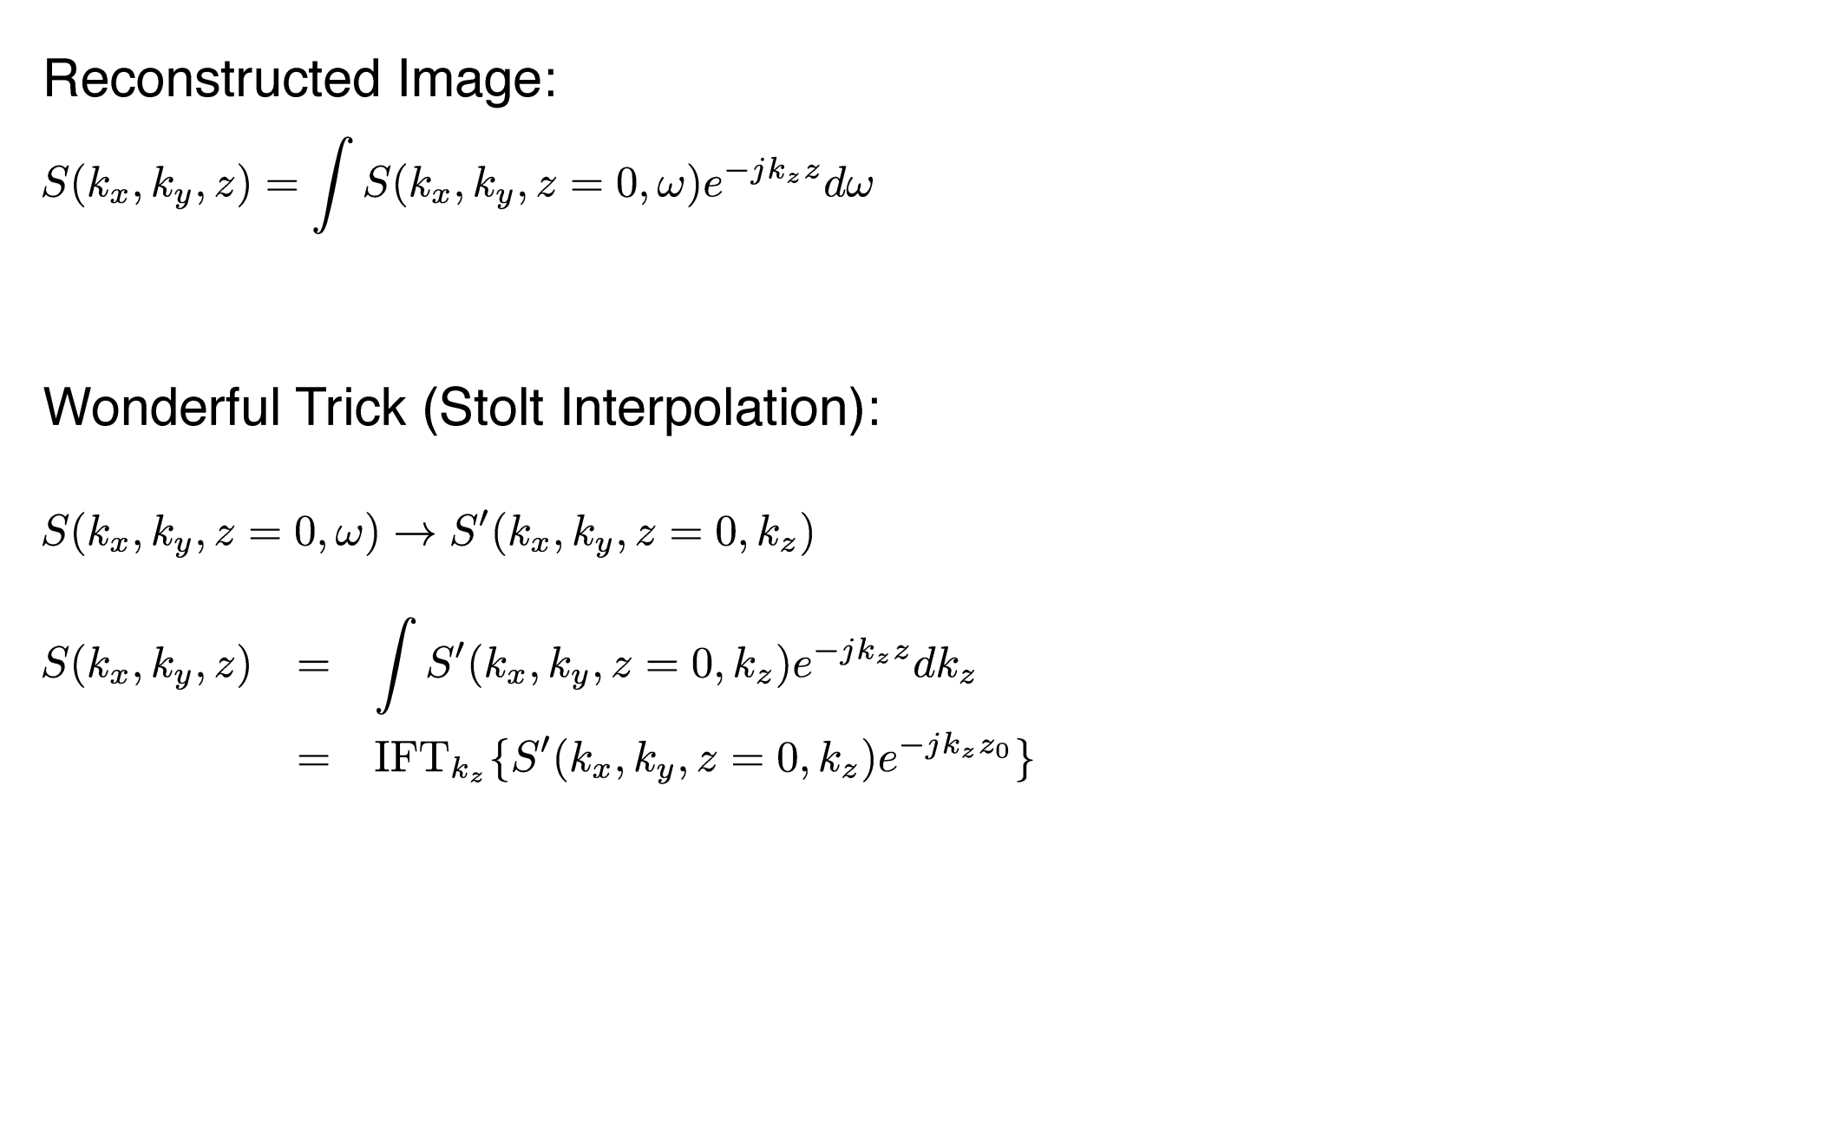
How it Works

Slide 15
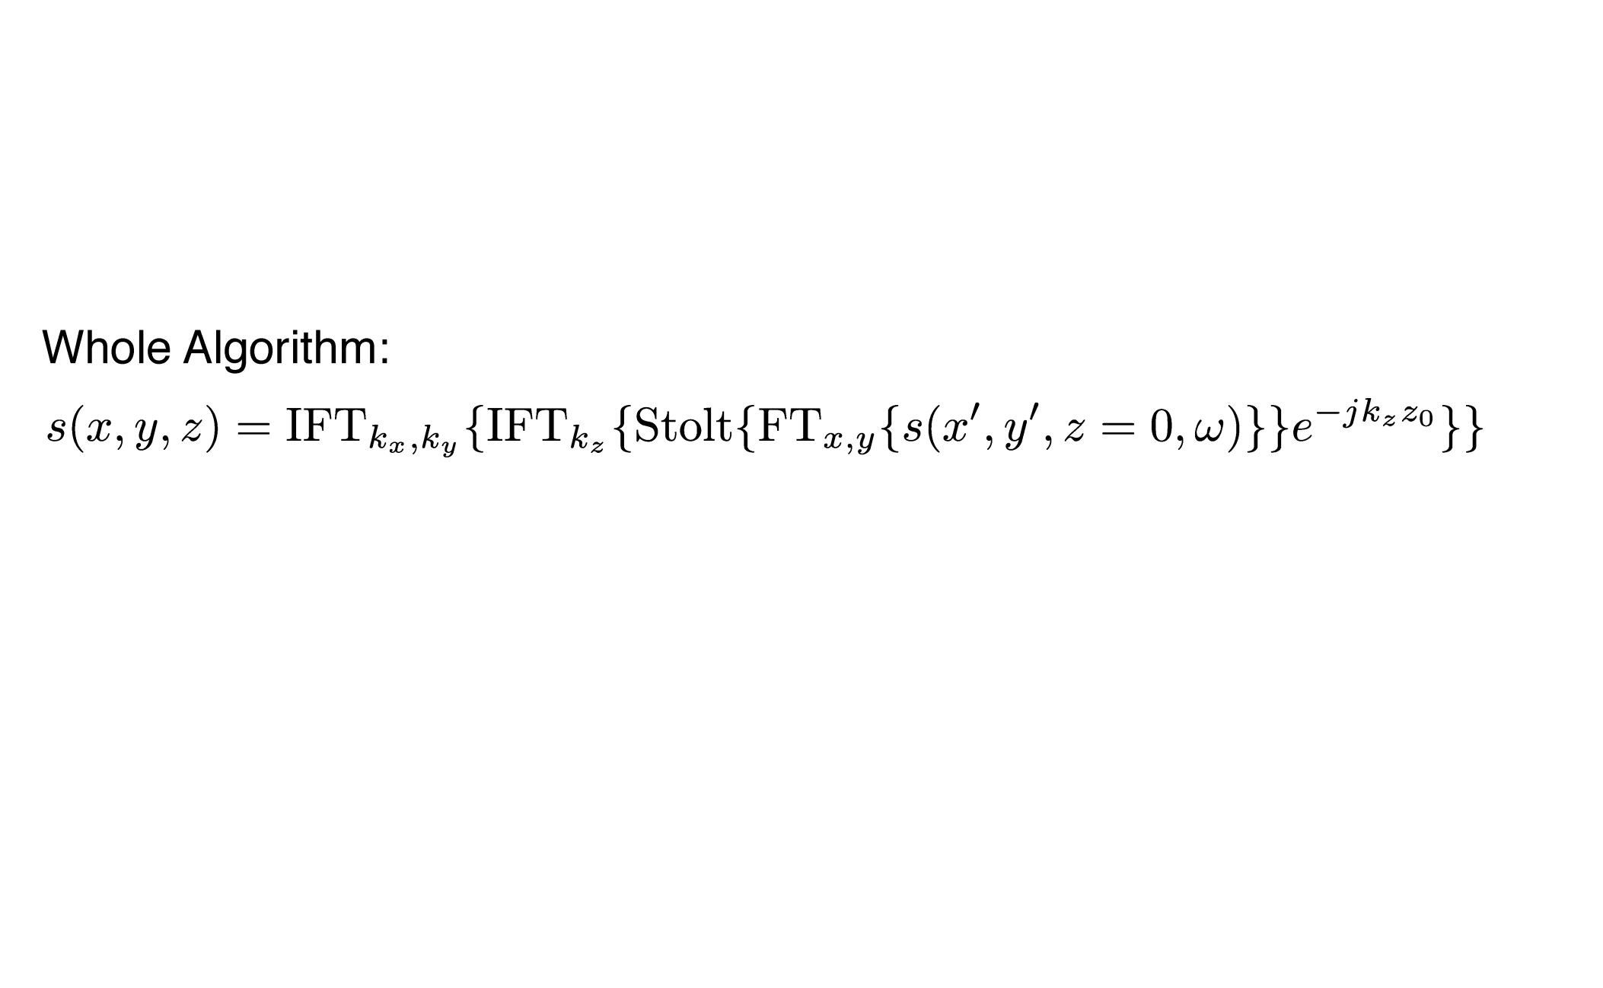
How it Works

Slide 16
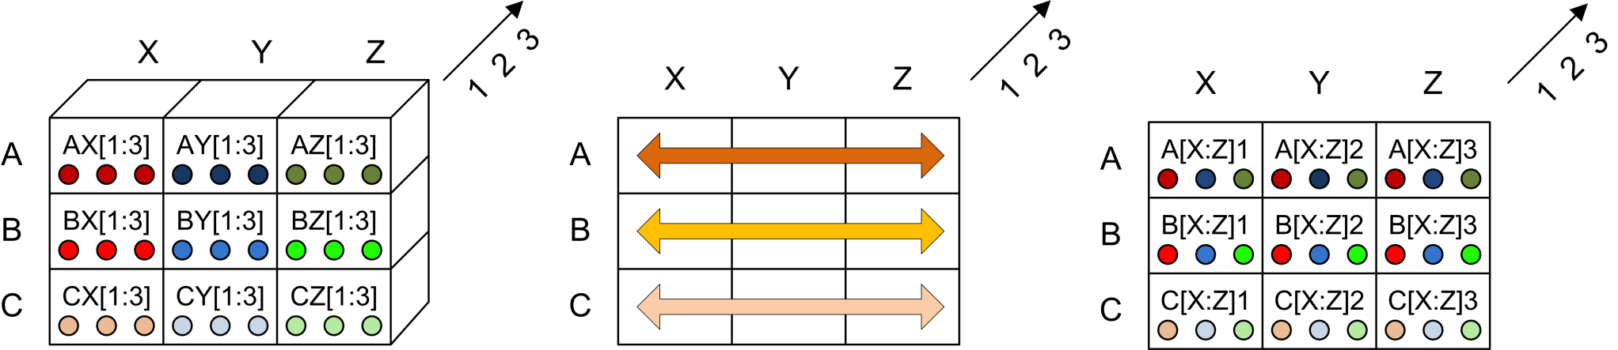
The Row-wise Transpose
Before Transpose
After Transpose
Each processor sends its local data to all other processors in the row.
Each node extracts data and forwards after each hop.
Requires N-1 hops to perform full transpose.

Slide 17
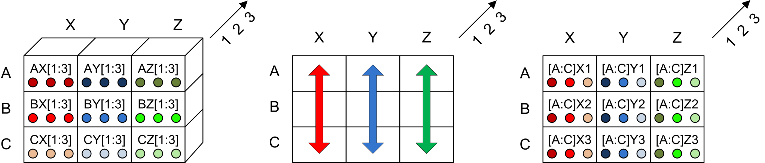
The Column-wise Transpose
Before Transpose
After Transpose
Each processor sends its local data to all other processors in the column.
Each node extracts data and forwards after each hop.
Requires N-1 hops to perform full transpose.

Slide 18
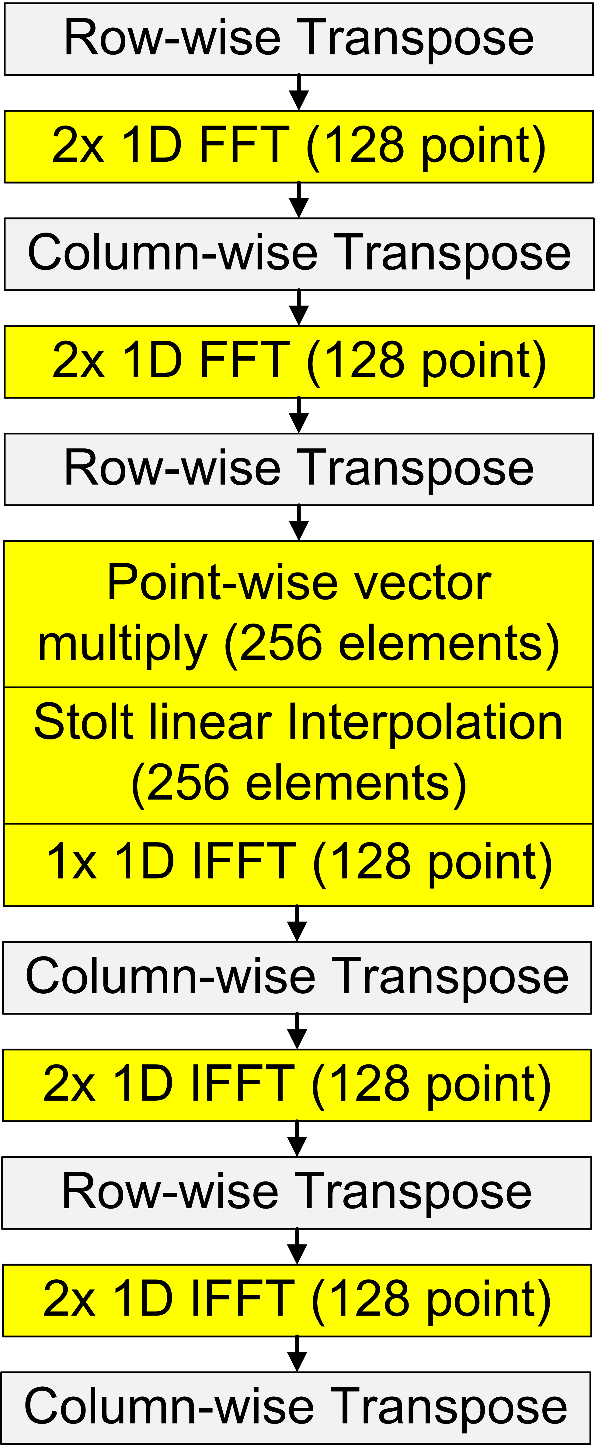
The 3D Imaging Algorithm
2D FFT
The algorithm that runs on each processor
Also known as the Fully Distributed pattern
Key:
Communication in grey
Computation in yellow
Backward propagation and Stolt
3D IFFT

Slide 19
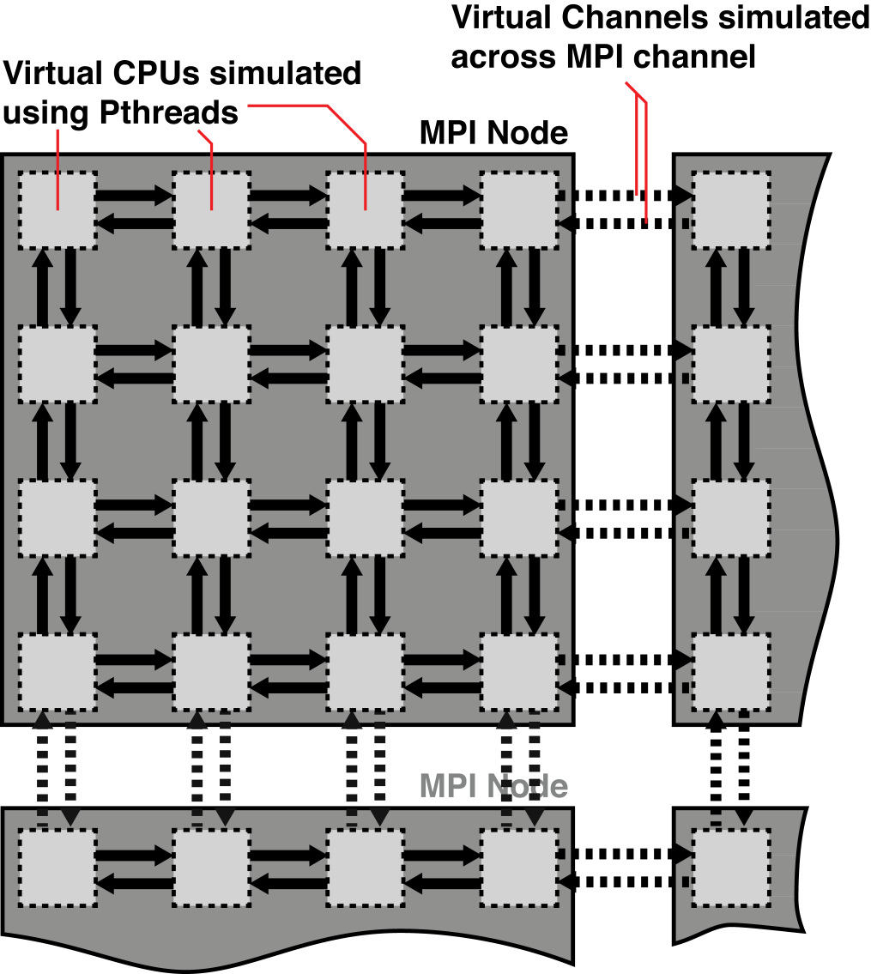
The Functional Simulator
For fast prototyping and debugging of eWallpaper applications.
Applications written in SPMD style. One program instance launched per CPU.
Each eWallpaper CPU simulated in its own thread.

Slide 20
The Functional Simulator
Mesh Network API
Minimal Communication Layer
send_message(direction, message, message_size)
receive_message(direction, message, message_size)
set_receive_buffer(direction, buffer)
Within a single MPI node, network functions are simulated using mutexes.
Across MPI node boundaries, network functions are simulated using MPI commands.
MPI node boundaries are invisible to the eWallpaper application.

Slide 21
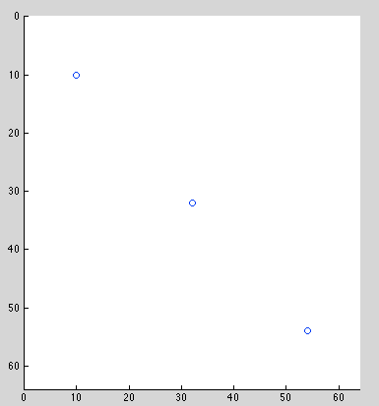
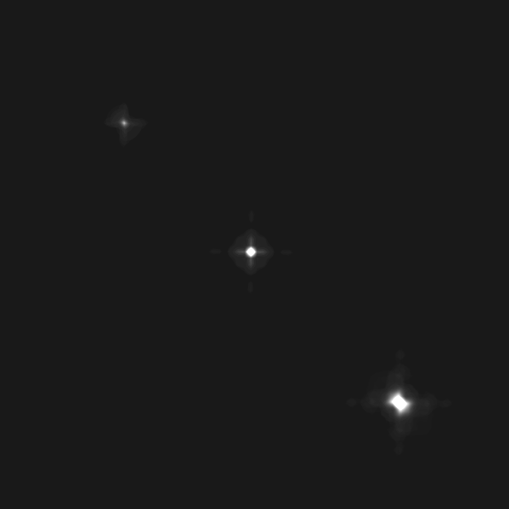
Imaging Results: 3 Points
Original Scene
Recovered Scene

Slide 22
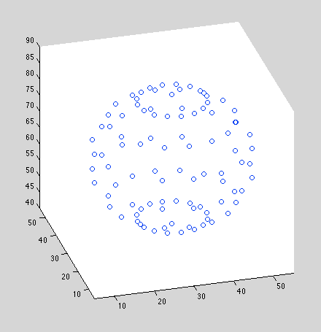
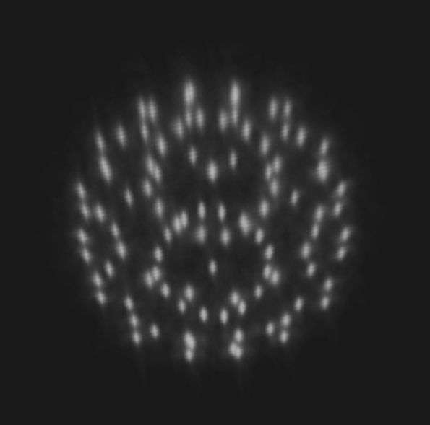
Imaging Results: Sphere
Original Scene
Recovered Scene

Slide 23
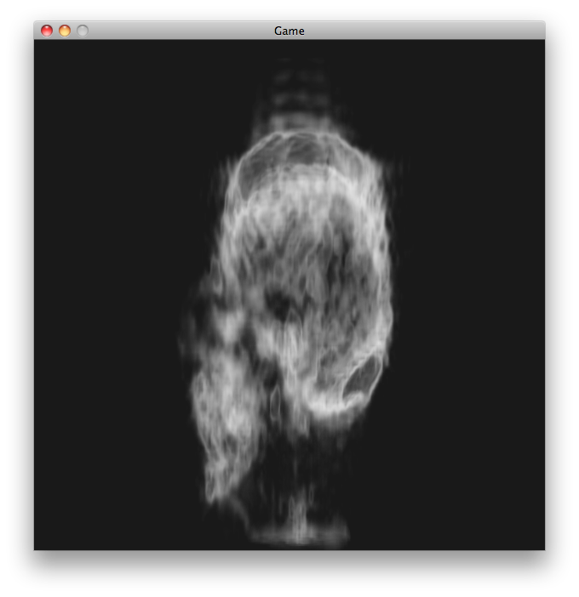
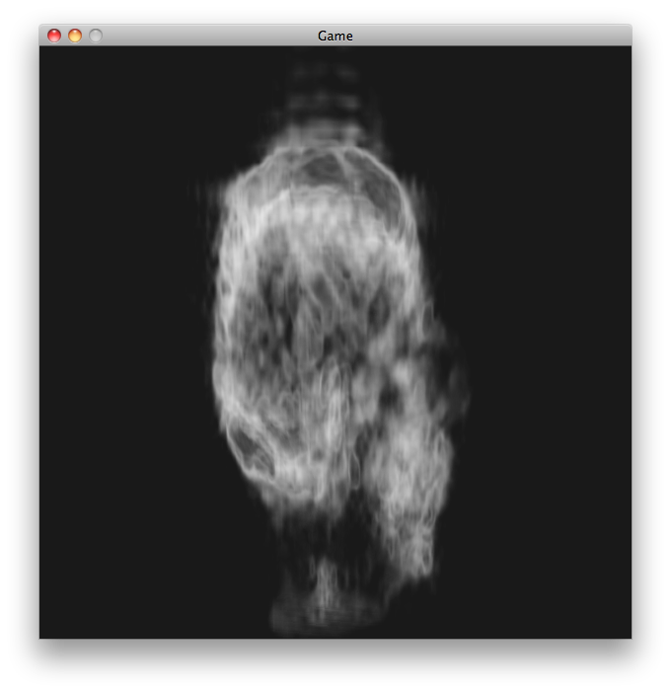
Imaging Results: Human Skull
Recovered Scene
Recovered Scene

Slide 24
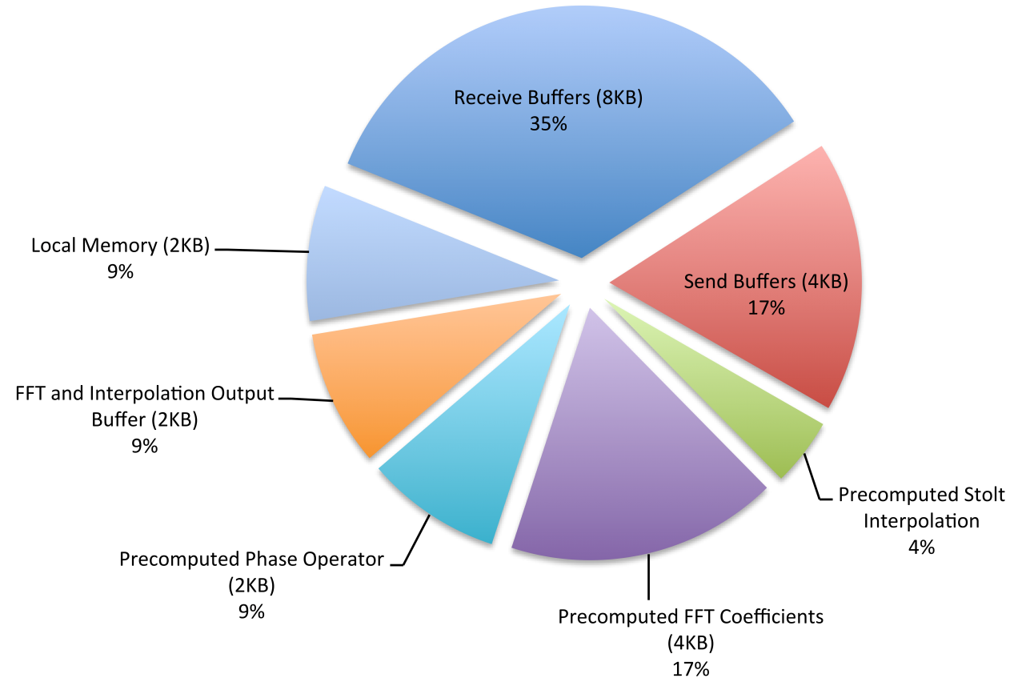
Timing and Memory Model
Timing model developed from analysis of application code running on functional simulator
Processor spends > 90% of its time communicating
Memory requirements are shown here

Slide 25
Network Simulator
Python-based discrete-event simulator accurately simulates network traffic on eWallpaper
Simulated inter-processor communication events:
Packet transmission
Arrival of packet head
Arrival of packet tail
Acknowledgement of packet reception
Network buffer full/empty
Timing of events based on projected link bandwidth and latency of eWallpaper network:
Allows performance of different communication patterns to be predicted

Slide 26
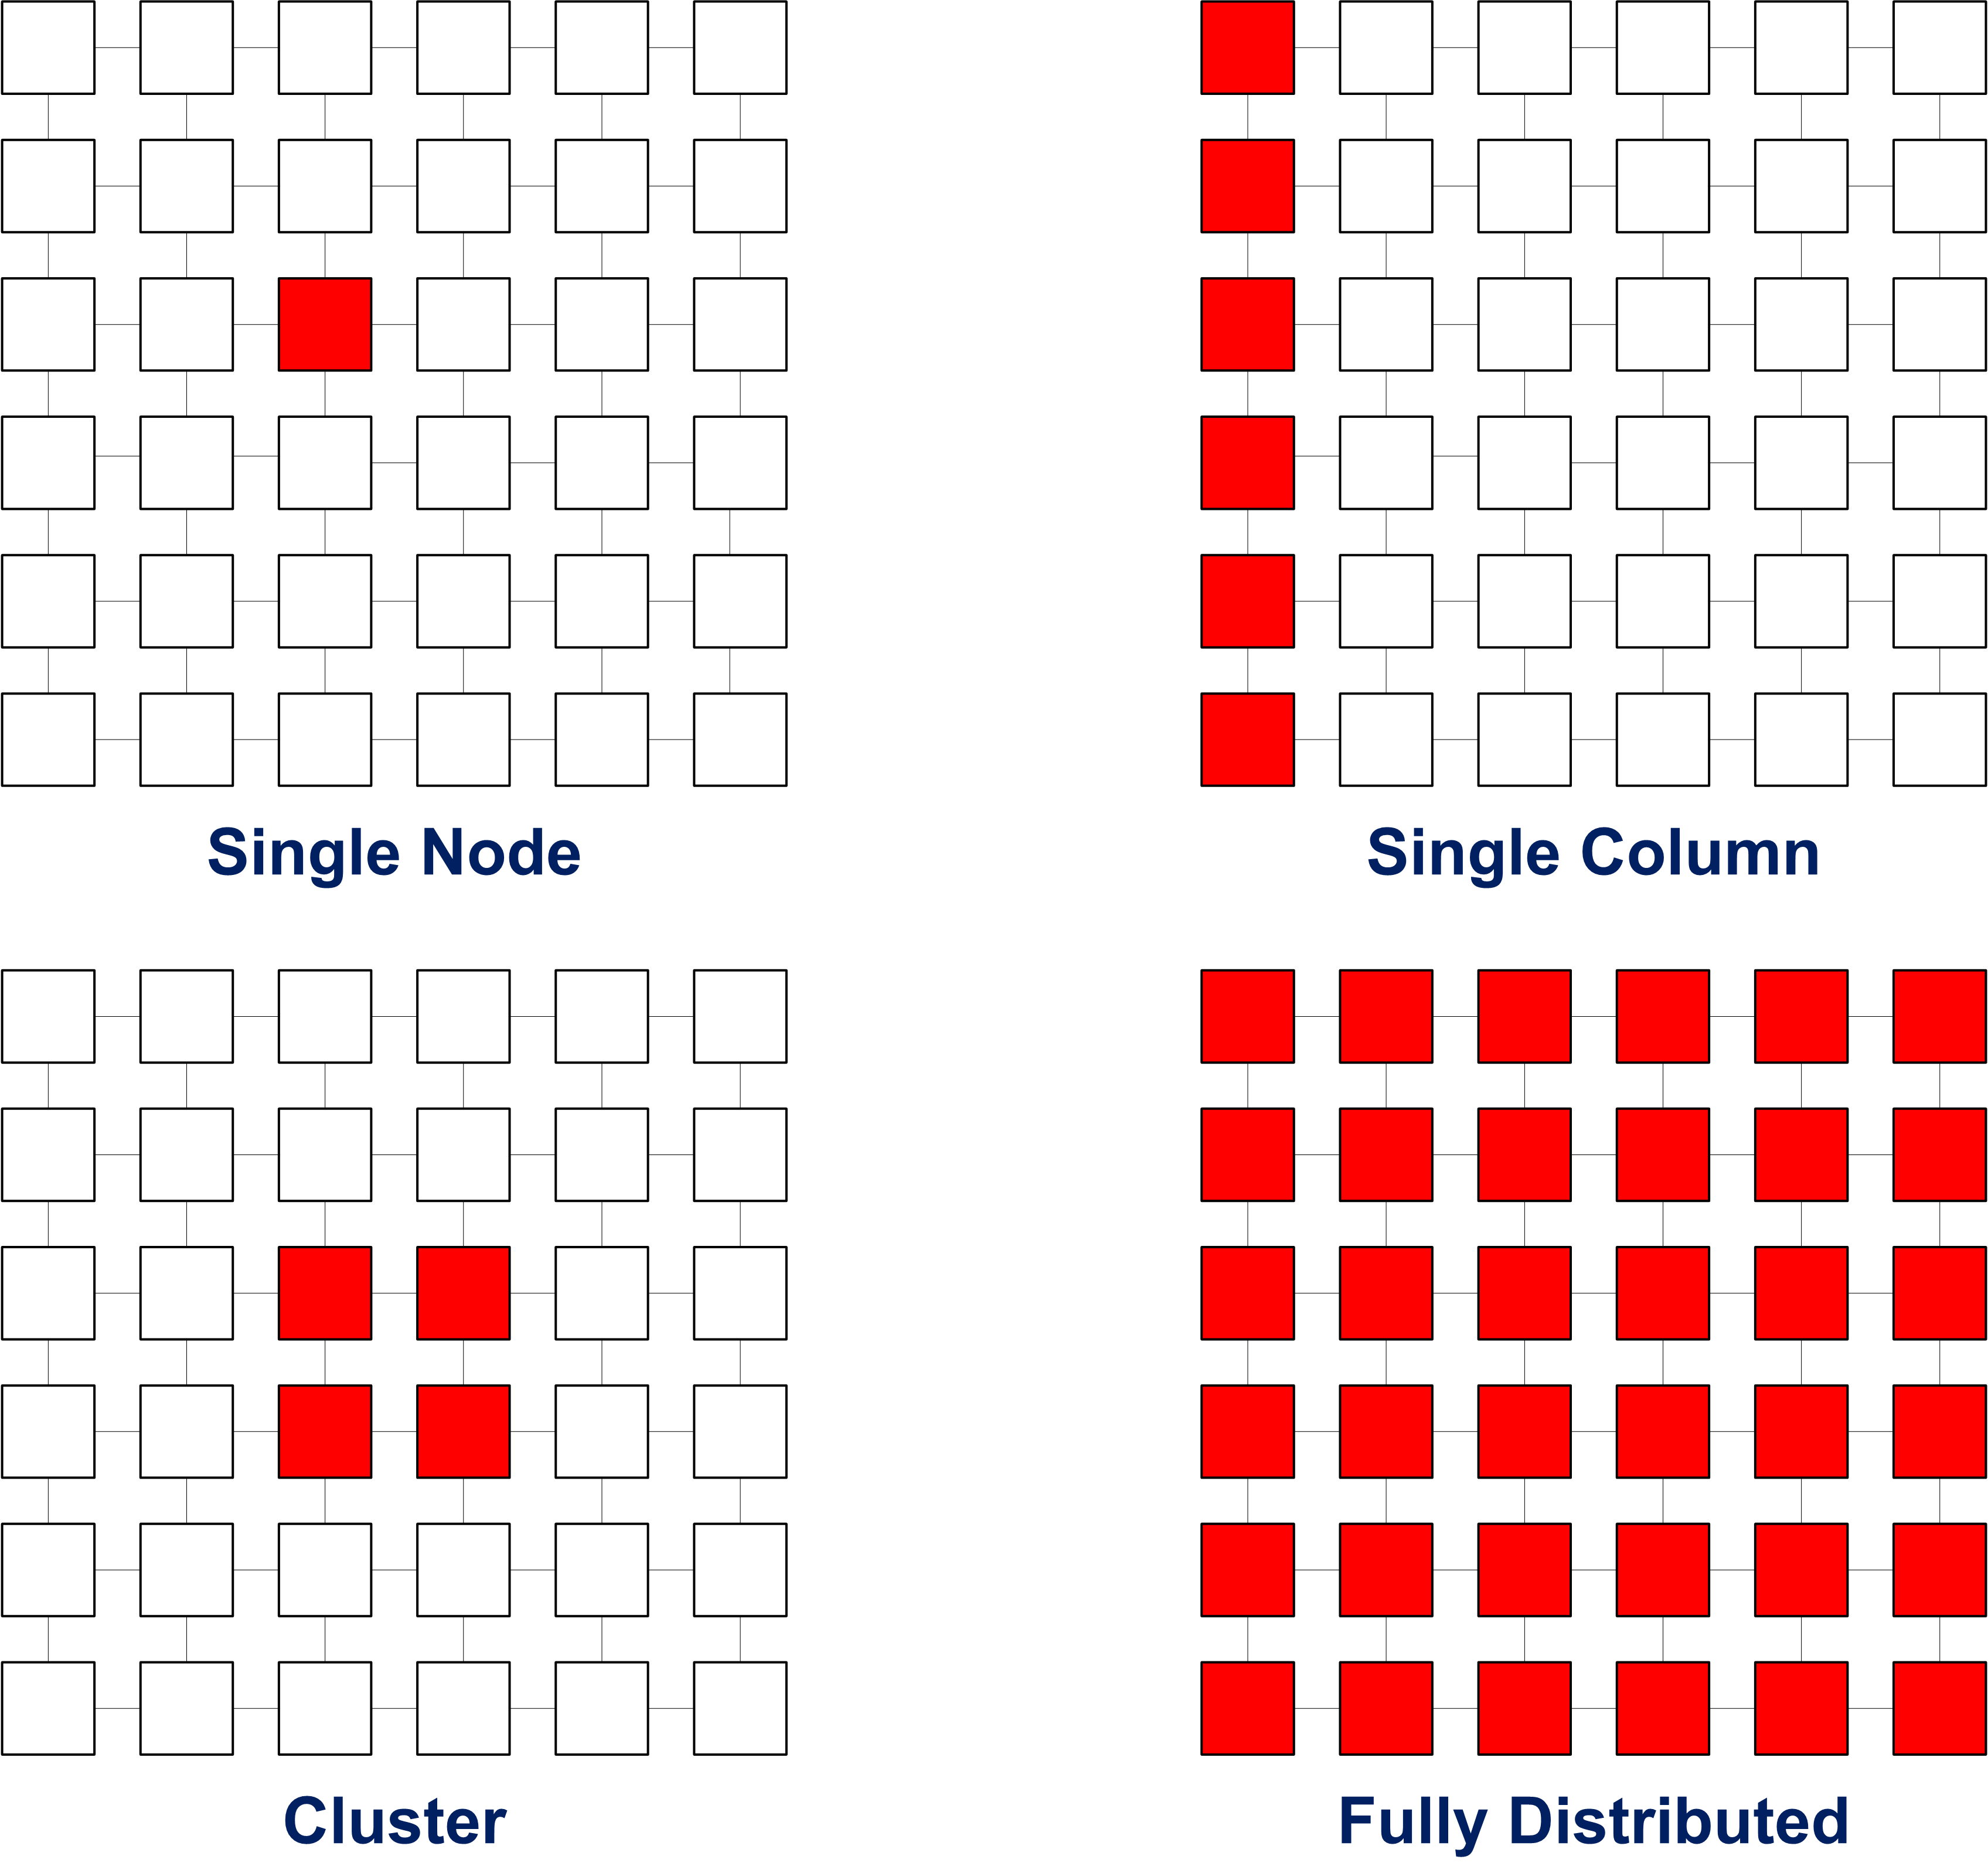
Communication Patterns
(our algorithm)

Slide 27
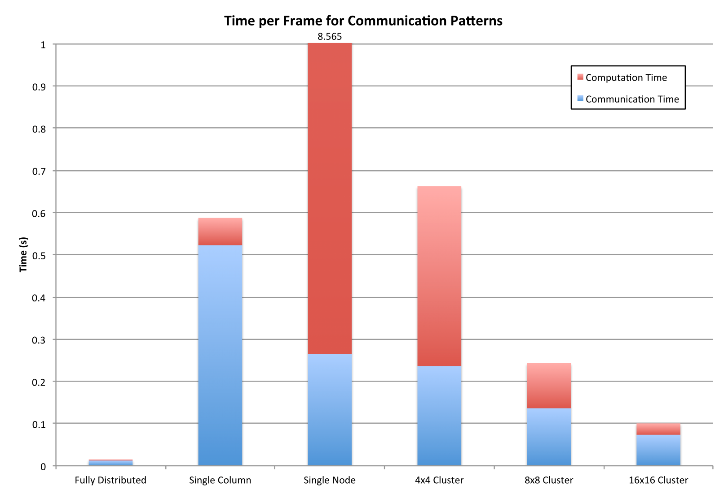
Communication Patterns: Speed
Only Fully Distributed and 16x16 Cluster are fast enough to deliver realtime video framerates

Slide 28
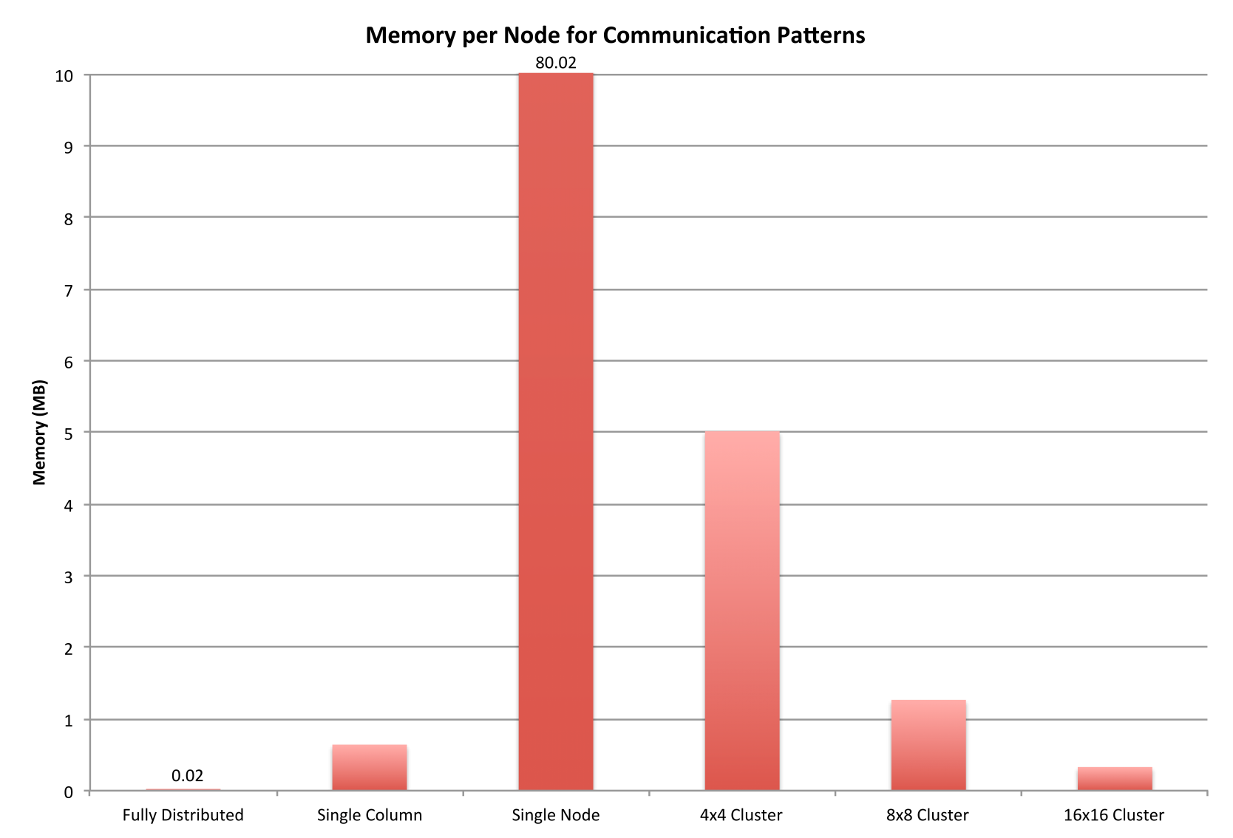
Communication Patterns: Memory
All patterns, except Fully Distributed and 16x16 Cluster, exceed the available memory per node (100KB)

Slide 29
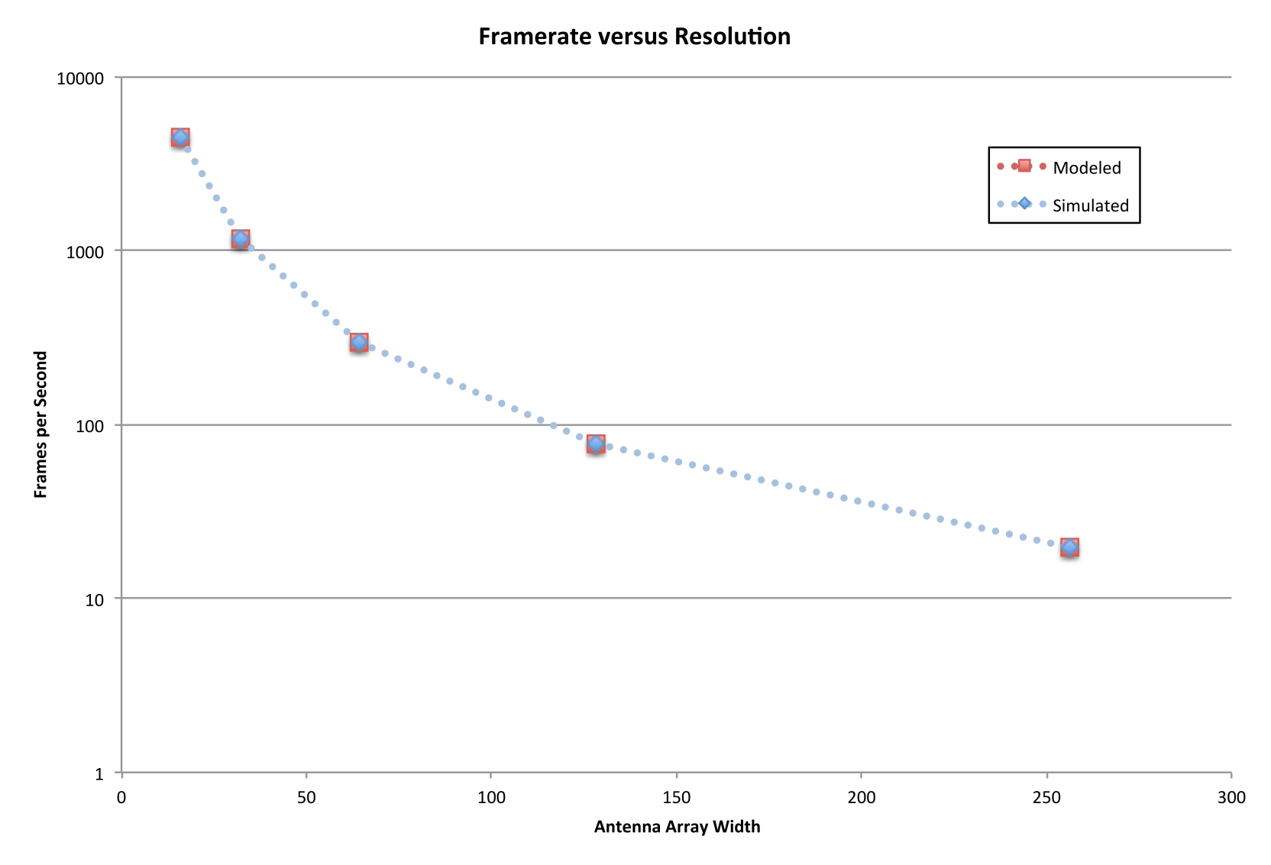
Framerate vs. Resolution
At planned resolution of 128 x 128 antennas, framerate of 75 fps is achieved

Slide 30
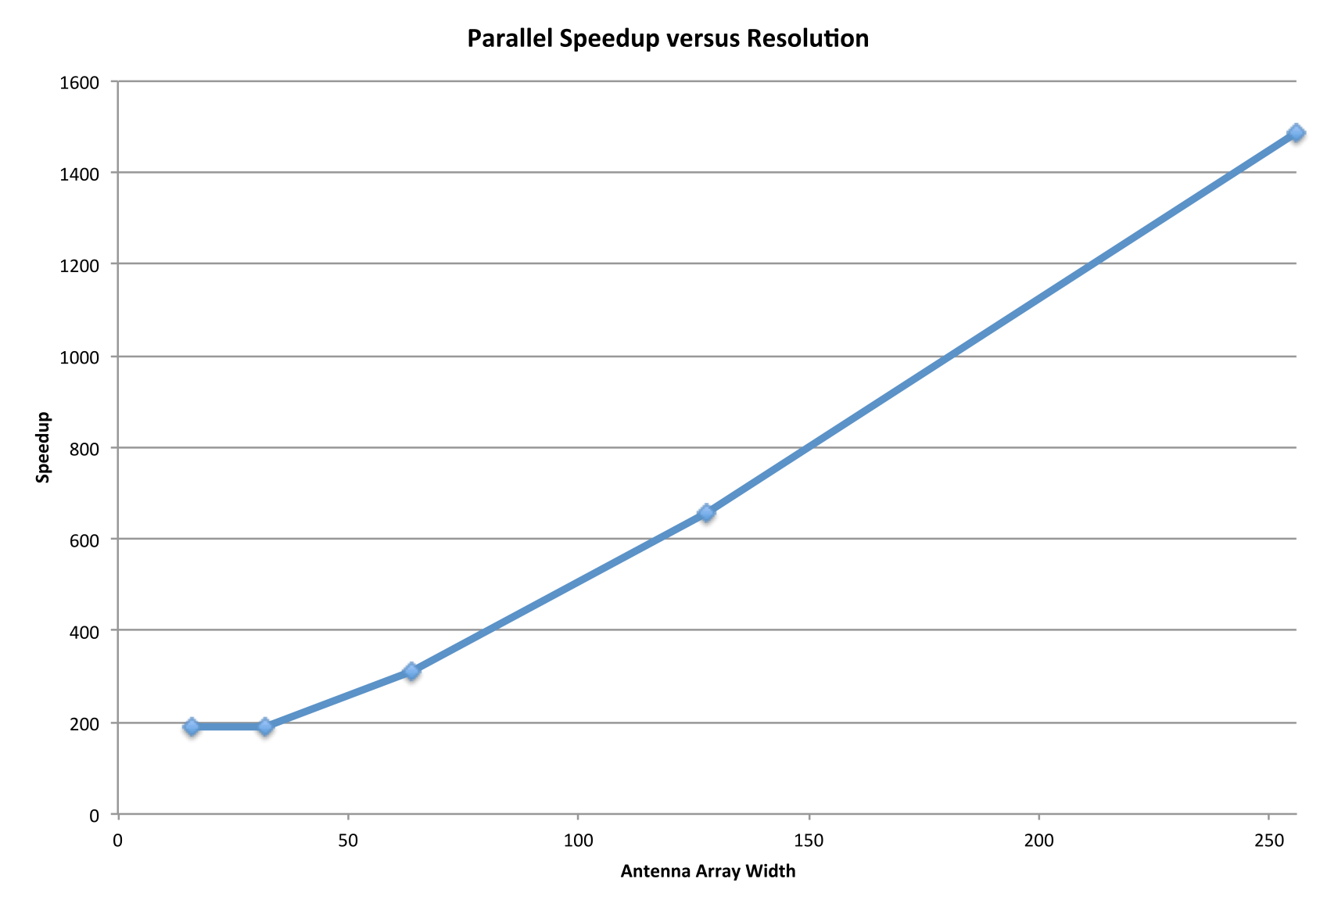
Speedup vs. Resolution
At resolution of 128 x 128, our algorithm (fully distributed pattern) is 600 times faster than a serial implementation (single node pattern)

Slide 31
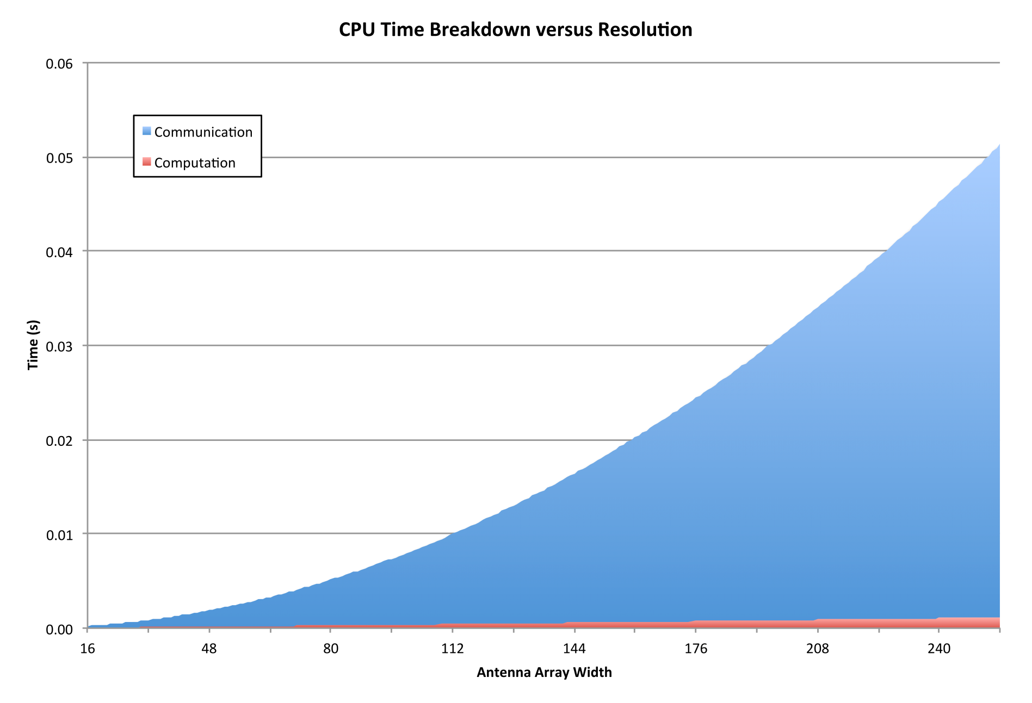
CPU Time Breakdown vs. Resolution

Slide 32
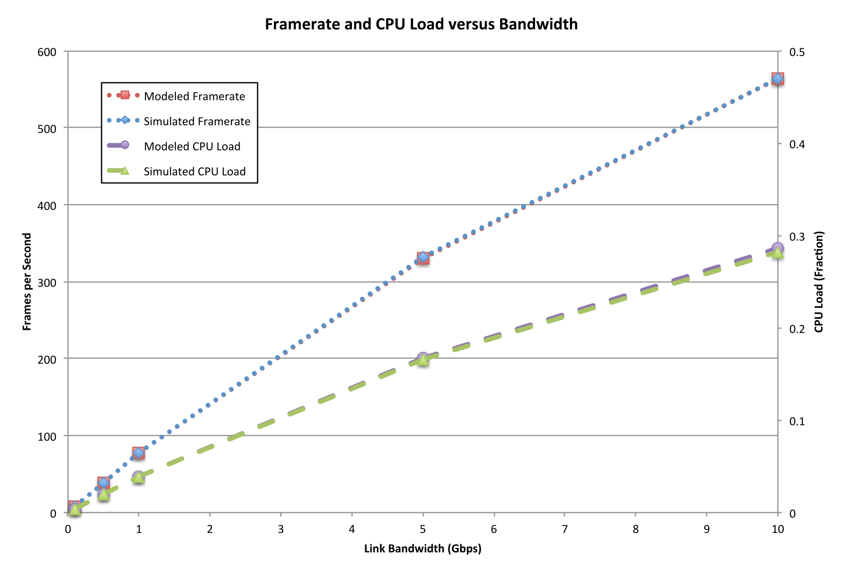
Effect of Changing Bandwidth
At proposed link bandwidth of 1Gbps, the achieved framerate of 75 fps results in CPU utilization of 0.03

Slide 33
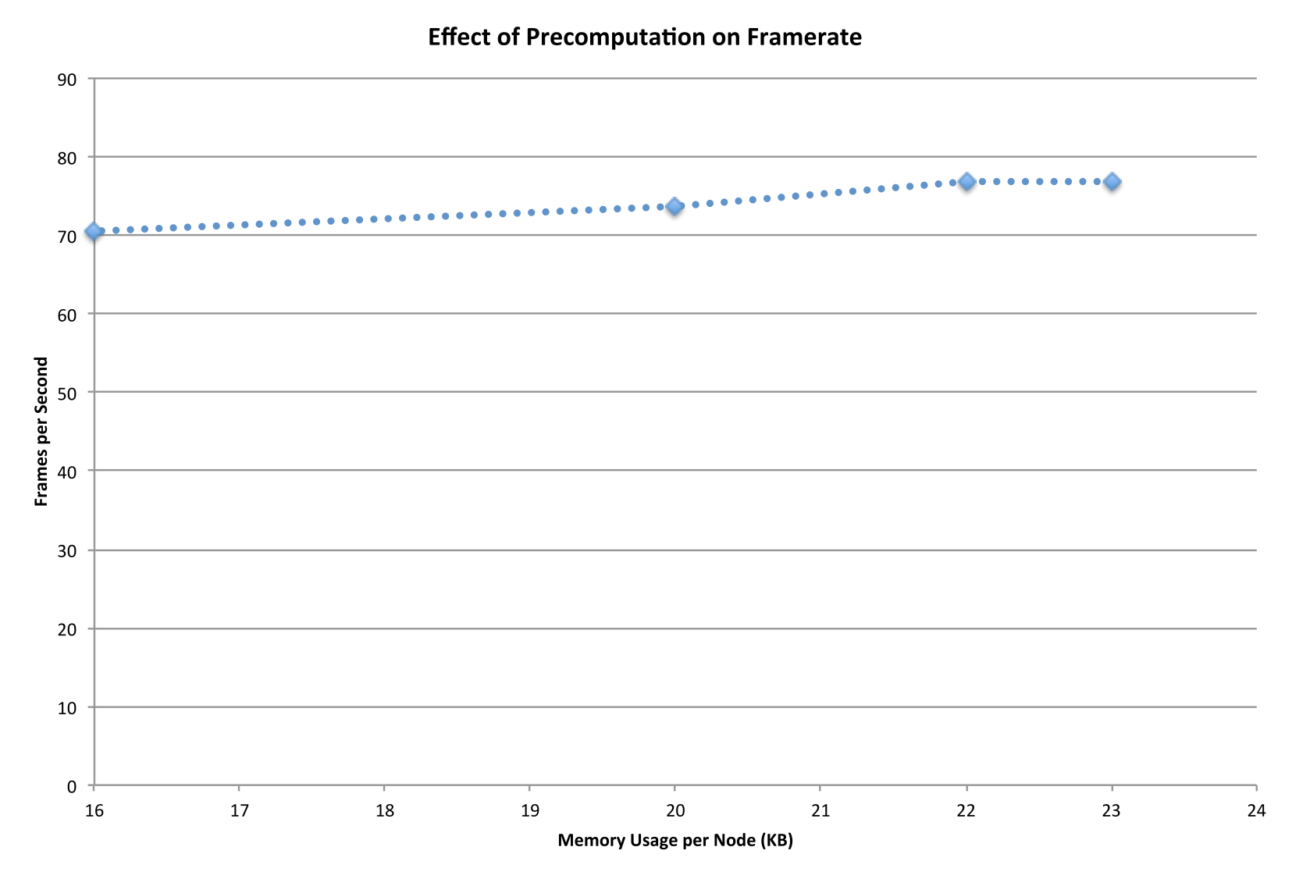
Effect of Precomputation
Higher framerates can be achieved if FFT, Stolt and backward propagation coefficients are precomputed, but at the expense of memory.

Slide 34
Conclusions
Developed functional simulator for eWallpaper simulations
Timing model and network simulator allow performance of applications to be predicted
Our parallel imaging algorithm achieves realtime video framerates with feasible memory and bandwidth requirements

Slide 35
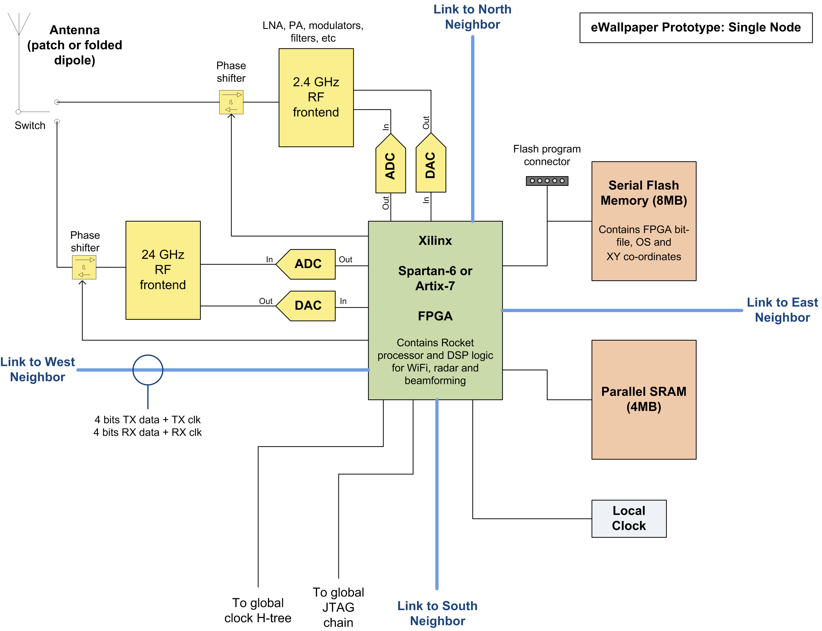
Future Work

